Slide 1
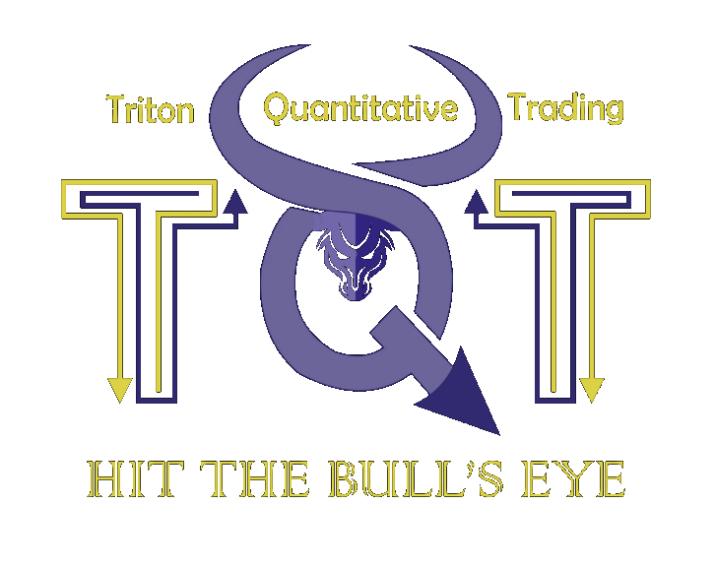

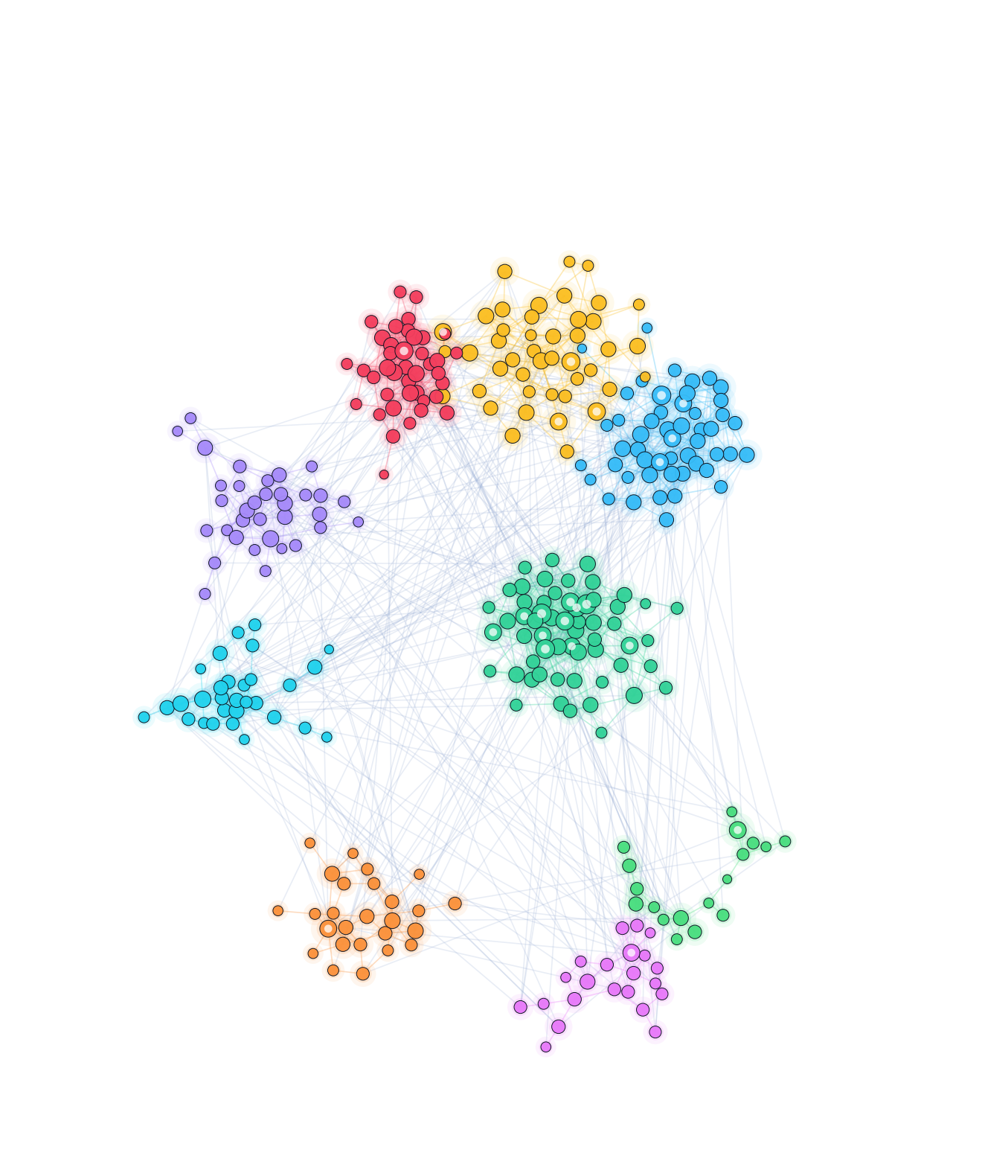
DATA ENGINEERING · UNSUPERVISED ML · QUANTITATIVE ANALYSIS · ETHEREUM
ChainSense
Identifying Behavioral Archetypes of 6.3M Ethereum wallets
PRESENTED BY [ Chris Kim. Laksh Goyal. Devang Pant. Ojas Dessai. ]
[ DS3 @ UC San Diego / Mentored by Tanishq Jain ] · 2026
Notes:
HOOK (~15s). Open with the punchline, not the agenda.
"Ethereum is public but anonymous — millions of wallets, no labels. We built a pipeline that labels 6.3 million of them by behavior alone — and it surfaced ~159,000 phishing-drain wallets we never told it to look for."
Then: "In 5 minutes: the problem, how we built it, what we found, and a live demo."
Fill in your name(s) and course on this slide before presenting.

Slide 2
02 / BACKGROUND & PROBLEM
Ethereum is publicly anonymous
A rare, open record of real economic behavior — hiding in plain sight.
THE RAW MATERIAL
Public & permissionless
Every transaction is open and immutable — no paywall, no NDA, no vendor.
1 year
Banking keeps this locked
Real transaction data is private and expensive, walled off behind institutions.
OF ETHEREUM BLOCKS INGESTED
6.3M
Anonymous, not unknowable
No identity needed — behavior at scale is free to study. A rare research opening.
ACTIVE WALLETS (>10), 511M TRANSACTIONS
Problem: Build data pipeline to collect data, extract information,
and characterize behavior at scale.
ChainSense
02 / 10
Notes:
(~35s) Frame the problem + real-world relevance.
- Blockchains are radically transparent yet pseudonymous: you see every move, but not the actor or their intent.
- Today's labels (Nansen/Arkham/Chainalysis) are manual, proprietary, reactive — and academic address-clustering work is mostly de-anonymization, not behavior.
- Our bet: you can characterize BEHAVIOR without identity, and do it at scale.
Land the bold line: characterize behavior at scale, unsupervised, from immutable logs.

Slide 3


03 / WHAT WE BUILT
From a one-shot clustering to a living behavioral system
ORIGINAL SCOPE
WHAT WE DELIVERED
Cluster a snapshot of wallets into a few archetypes (traders, holders, bots), over limited scope.
A static, one-time analysis.
A short slice of blockchain history.
A dashboard showcasing findings.
Batch ETL over 1 Year
partition → clean → features → normalize → train
A self-built live pipeline that ingests new transactions and classifies wallets in real time (12s intervals)
An analytics dashboard with live data from pipeline
6.3M
511M
18
WALLETS ANALYZED
TRANSACTIONS
BEHAVIORAL CLUSTERS
+
ChainSense
03 / 10
Notes:
(~30s) This is your ORIGINALITY slide — the rubric rewards it.
- We didn't just cluster a snapshot. We scaled to a full year, then went further than the brief.
- Two additions worth naming out loud: (1) archetype-over-time, and (2) real-time inference that labels brand-new / previously-unclustered wallets on the fly.
Point at the right column: "everything in green is beyond the original ask."

Slide 4
04 / SYSTEM ARCHITECTURE
An infrastructure-aware, dual-path pipeline
① BATCH — cluster, distill, train (offline)
BigQuery
1yr · 511M txns
Feature build
26 features
HDBSCAN
cluster 10%
XGBoost ①
label 90%
trained model ②
② REAL-TIME — classify new wallets live
Alchemy
live stream
Feature build
same 26 · 1h
XGBoost ②
new EOA · ms
FastAPI · SSE
→ React UI
STACK
VALIDATION · ETHERSCAN CROSS-CHECKS · TOP-20 4-BYTE SELECTORS
Python
DuckDB
FastAPI
XGBoost
HDBSCAN
BigQuery
Alchemy
React + Vite
SQLite
Vercel
ChainSense
04 / 10
Notes:
(~30s) Solution clarity + design reasoning.
- Trace the top lane left-to-right ONCE: bulk pull -> features -> HDBSCAN on Google Cloud -> trained XGBoost.
- The key design idea: the SAME 26 features and the SAME model power a live lane — Alchemy stream -> predict in ms -> stream to the UI over SSE.
- Why cloud? HDBSCAN is compute-heavy at this scale; batch it offline, then inference is cheap online.
Don't read the stack chips — they're there to answer 'what did you use'.

Slide 5
04 / METHODS
Why density-based clustering — not K-Means
✕ K-MEANS rejected
✓ HDBSCAN chosen
Must pre-pick k; forces every wallet into a round cluster.
No concept of noise — bots & outliers contaminate every group.
Smears rare behaviors (like phishing) into the big clusters.
Density-based — discovers the cluster count itself.
Isolates ~38% of the 634K sample as noise → honest archetypes.
Compute-heavy → we ran it on Google Cloud.
SCALING IT LIVE — XGBOOST
HDBSCAN labels a 634K-wallet sample → XGBoost learns the cluster boundaries → labels all 6.3M wallets — and any new one — in milliseconds.
ChainSense
05 / 10
Notes:
(~35s) THE design-reasoning slide (rubric: reasoning & design choices). Slow down here.
- K-Means fails for us on principle: it has no notion of NOISE, so bots and rare actors get forced into clusters and pollute them. It also needs k up front.
- HDBSCAN is density-based: it finds the number of clusters AND sets ~38% aside as noise. Refusing to label is exactly what you want for honest archetypes.
- The catch: HDBSCAN doesn't scale to millions cheaply -> so we cluster a sample, then train XGBoost on those labels to generalize to all 6.3M and to live wallets in ms.
If asked 'why not DBSCAN?': HDBSCAN handles varying density and needs no epsilon.

Slide 6
06 / LIVE DEMO
▶ Live Demo
Real-time Classification · Archetypes Tally Over Time · Wallet inspector
Live stream
Cluster analysis
Archetypes over time
Wallet inspector
Feature Space
chainsense-eth.vercel.app
ChainSense
06 / 10
Notes:
(~45-60s) The demo. Keep it tight and rehearsed.
SCRIPT: (1) Live page — show wallets being classified in real time over SSE. (2) Cluster/archetype view — point to the phishing family. (3) Wallet inspector — paste one address, show its features + label.
FALLBACK: backend runs on your Mac behind a Tailscale Funnel — if the network/tunnel is flaky, have screen-recordings or screenshots ready and narrate those. Don't debug live.
Start the backend BEFORE the talk; first /api/stream loads a large lookup table.

Slide 7
07 / SIGNALS → STRATEGY
Can “smart-money” flow predict price?
The hypothesis
If the clusters found genuine smart money, that cohort’s net ETH flow should predict price moves a random cohort can’t.
What actually correlated
Of four smart-money archetypes, only Power-Protocol-User and Whale showed even a weak flow-vs-price link. The rest: none.
The test
One asset, one position + continuous rebalance on ETH/USD — does trading the z-score beat buy-and-hold?
ChainSense
07 / 10
Notes:
(~15s) Set up the test honestly — this is a hypothesis, not a victory lap.
- Claim: if the clusters found REAL smart money, that cohort's net flow should predict ETH price.
- We turned net hourly ETH flow per archetype into 168-hour rolling z-scores, then traded them in QuantConnect.
- Foreshadow: only ONE archetype (power-protocol-user) even weakly correlated — say it now so the negative result reads as rigor, not surprise.

Slide 8
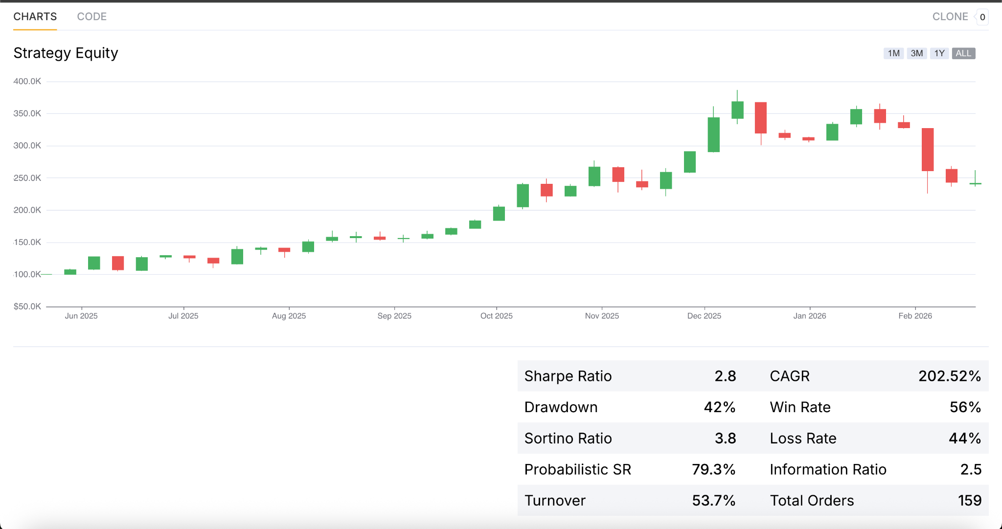
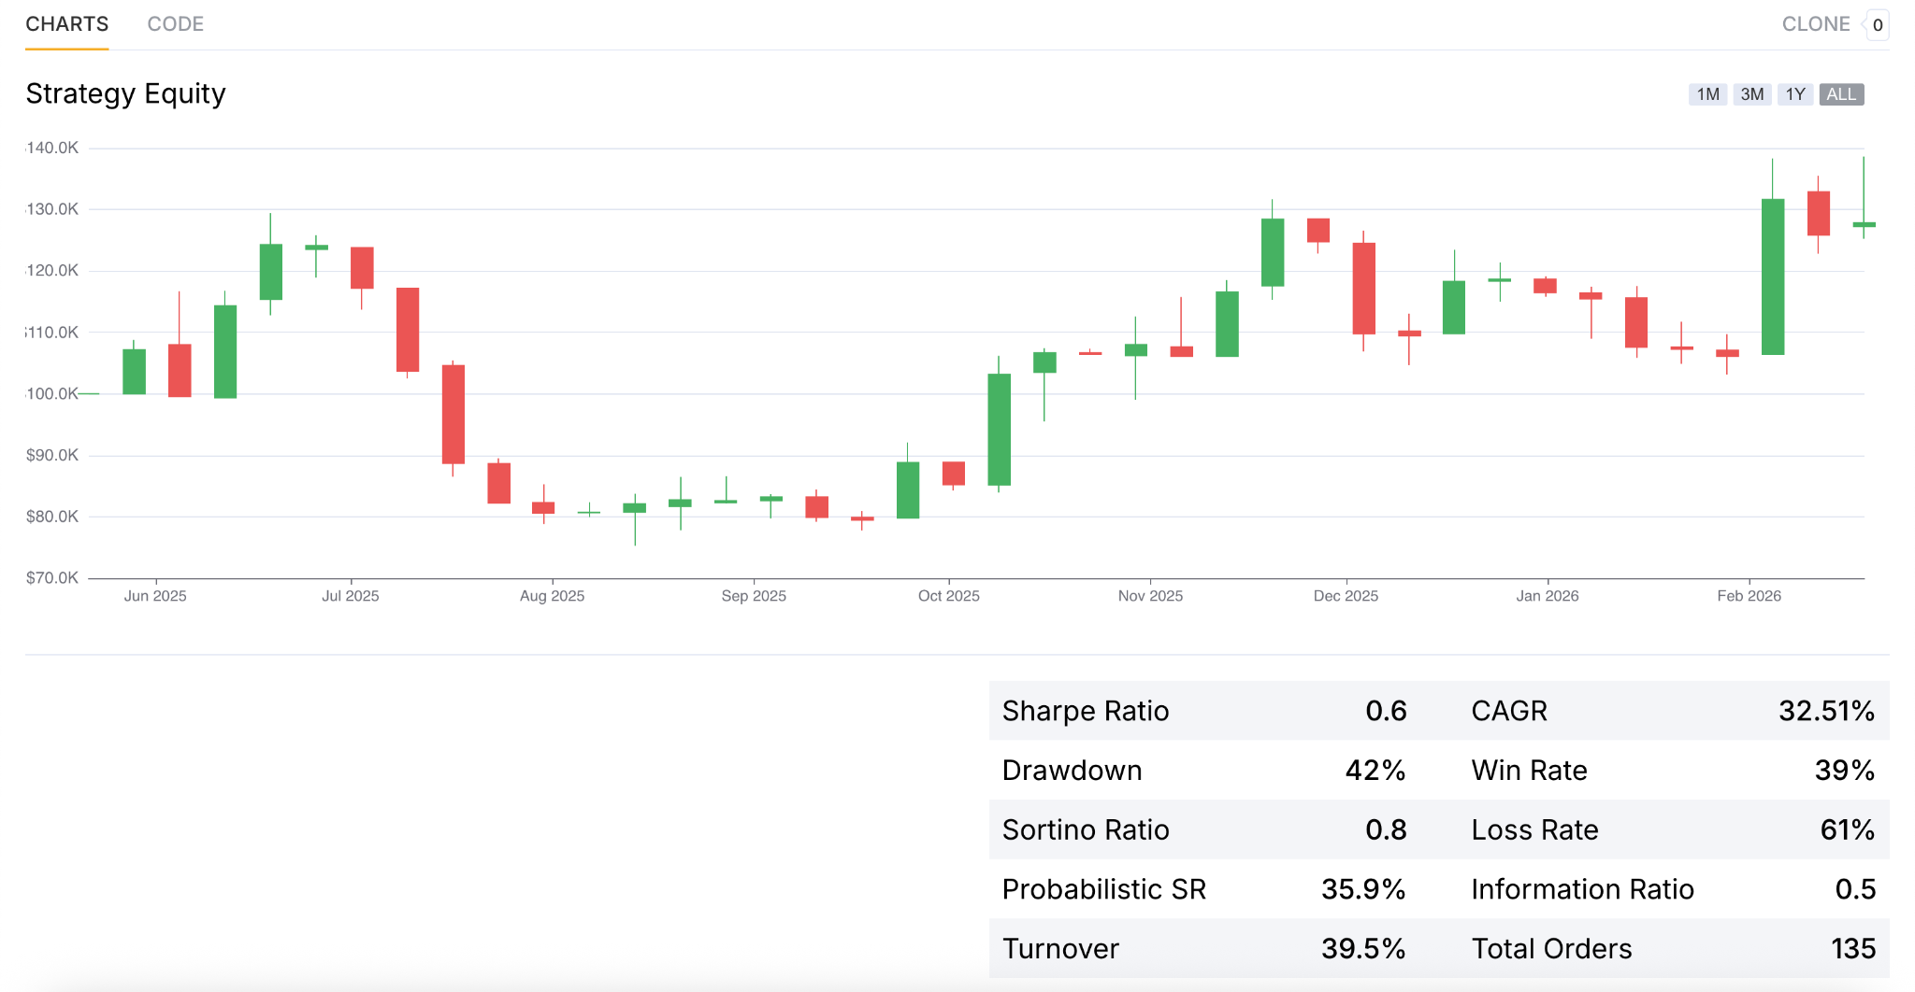
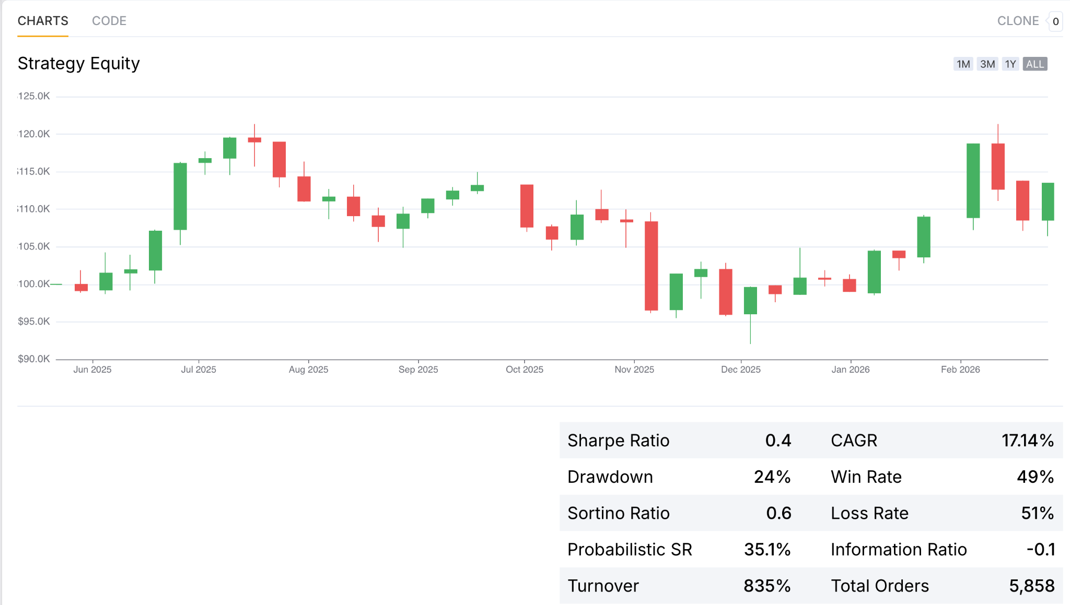
08 / BACKTEST
Two backtests: one flashy, one honest
LONG + SHORT
SHORT-ONLY · SIGNAL ISOLATED
CONTINUOUS REBALANCE
Long + Short equity curve
save the screenshot as backtest_long_short.png
Short-only equity curve
save the screenshot as backtest_short_only.png
Sharpe 2.8 · CAGR 202% · PSR 79.3%
Sharpe 0.6 · CAGR 32.5% · PSR 35.9%
Sharpe 0.4 · CAGR 17.1% · PSR 35.1%
Looks elite — but it’s mostly ETH beta in a rally.
Strip the market beta and the edge disappears.
No beta to strip yet only a whisper of a signal
PSR 35.9% (short-only) → ≈ 64% probability the true Sharpe ≤ 0 — QuantConnect flags it as not statistically significant.
ChainSense
08 / 10
Notes:
(~20s) Show both, then puncture the flashy one.
- Long+short looks elite: 2.8 Sharpe, 202% CAGR. But the window was a strong ETH rally and the LONG leg earned almost all of it — beta, not alpha.
- So we isolated the actual signal: short-only. Sharpe collapses to 0.6 and the probabilistic Sharpe (PSR) is 35.9% — QuantConnect's own test says: not significant.
- One line, then advance: 'the impressive number was the market; the signal alone has no demonstrated edge.'

Slide 9
09 / HONEST READ
The honest result is a negative one — by design
WHY IT’S BETA, NOT ALPHA
WHAT WE ACTUALLY LEARNED
The long+short looked elite — but the long leg was just ETH beta in a rising market.
Isolate the signal and it fails significance: PSR 35.9% — ~64% odds the true Sharpe is ≤ 0.
3 of 4 archetypes showed ≈ zero flow-vs-price correlation. The one that “worked” was cherry-picked.
Most likely it was inverse-beta plus luck on a small sample — not a real edge.
Archetypes describe better than they predict: the cluster mix may read market regime.
Next step: beta-neutralize and confirm it across multiple regimes.
A rigorously-shown null beats a fragile positive. Archetypes failed as a price predictor — but as a read on market regime, they may still earn their keep.
ChainSense
09 / 10
Notes:
(~20s) THE rigor slide — this wins 'reasoning' and 'professionalism' points. Slow down.
- Own it: the flashy number was market beta; the isolated signal has no statistically significant edge.
- Name the selection-bias risk yourself (we tested every archetype) — graders respect that more than a polished positive.
- Thesis: a rigorously-demonstrated NULL result is real, credible science. The pipeline works; the signal alone doesn't beat the market — yet.

Slide 10
ETHEREUM · UNSUPERVISED ML · REAL-TIME
Thank you.
Questions?
158,906 phishing-drain wallets found by behavior alone —
across 6.3M wallets, labeled in real time.
[ Chris Kim. Laksh Goyal. Devang Pant. Ojas Dessai ] · github.com/anirudh9280/ChainSense · chainsense-eth.vercel.app
Notes:
(open floor) Restate the one-line takeaway, then invite questions.
ANTICIPATE: • Why HDBSCAN over DBSCAN? (varying density, no epsilon) • Ground truth / how do you know labels are right? (Etherscan validation + selector decoding) • Overfitting / leakage in XGBoost? (features are wallet-level aggregates; train on HDBSCAN labels, hold-out check) • How does real-time scale? (cheap inference; batch the heavy clustering) • Could adversaries evade? (yes — motivates the anomaly-detection future work).
Fill in team + repo before presenting.

